Slide 1




EDGE NOVA'26
SentinelAI
PRESENTED BY TEAM
NeuralShield
Girishwar R | Nikil

Slide 2
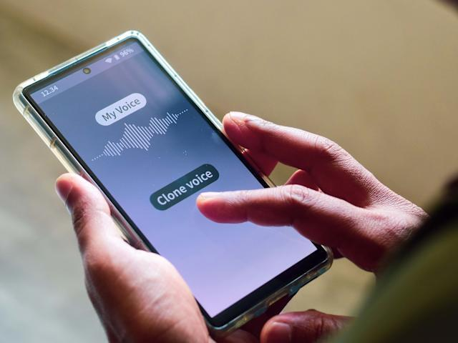

Problem Statement
The Threat: AI-powered scams — cloned voices on calls and phishing traps online — are getting harder to catch.
The Cloud Flaw: Today's cloud-based defenses add delay, need constant internet, and expose your private calls and screen activity to outside servers.
The Solution: SentinelAI solves this on-device: it listens and watches in real time, entirely offline, so no audio, screen data, or personal information ever leaves your machine.

Slide 3
Motivation
"The inspiration for SentinelAI came from an alarming reality: generative AI has weaponized social engineering at scale, while traditional cyber defenses remain fundamentally flawed. Today, deepfake voice cloning allows scammers to impersonate family members or financial executives with terrifying precision, while AI-powered phishing toolkits dynamically harvest credentials on unauthorized sites."

Slide 4
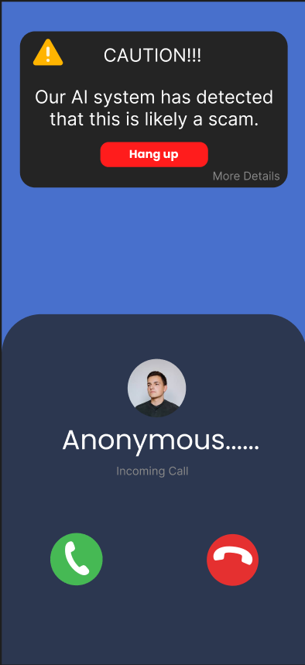
Abstract
SentinelAI: Air-Gapped Real-Time Multimodal Threat Interception via On-Device Intelligence
SentinelAI: An air-gapped, real-time multimodal threat interception system powered entirely by on-device intelligence.
Edge Architecture: Combines edge speech-to-text (Faster-Whisper Tiny) and a quantized Small Language Model (Phi-3-Mini via Ollama) to analyze context locally with sub-second latency.
Psychological Threat Detection: Evaluates live audio for behavioral scam signatures—like artificial financial urgency and family impersonation—rather than relying on basic blocklists.
Human-in-the-Loop Safety: Deploys actionable verification prompts (e.g., shared-secret challenges) instead of unsafe automatic disconnections, all operating within a highly efficient 2 GB RAM footprint.

Slide 5



How Our App Works
SentinelAI is a privacy-first Edge AI security system designed to protect users from modern digital scams without sending personal data to the cloud.
01
AI-Powered Scam Call Detection
SentinelAI analyzes phone calls in real time and looks for common psychological scam patterns, such as artificial financial urgency, impersonation, threats, and pressure tactics. The system does not automatically disconnect; it keeps the human in the loop with risk warnings.
02
Real-Time Phishing Detection
When entering sensitive information, SentinelAI monitors device activity for signs of phishing or fraudulent websites. If suspicious, the user receives an immediate warning before submitting data.
03
Privacy-First Edge AI
Processing happens directly on the user's device. This ensures better privacy, faster detection (no cloud round-trip), offline capability, and total user control over local data.

Slide 6


High-Level Working Concept
Voice Scam Interceptor
Context & Credential Guard
Captures live telecommunication audio via local system hooks, transcribing speech in sub-second latency using an edge-optimized model (Faster-Whisper Tiny).
Uses local screen-capture hooks and lightweight vision models to evaluate active workspace windows.
It identifies high-risk inputs (e.g., typing credit card or password data into unverified, look-alike domains) and evaluates local browser context without sending frames to the web.
An on-device Small Language Model (Phi-3-Mini via Ollama) evaluates the transcript for psychological scam signatures—such as artificial urgency, financial demands, and secrecy requests.

Slide 7






What Makes Our Approach Unique
100% Air-Gapped Operation
Psychological Signatures
Human-Centric Interception
Unlike commercial security tools that require constant API connections, Sentinel Edge operates completely offline with a RAM footprint under 4 GB, guaranteeing zero data leakage.
Instead of relying on static blocklists or simple acoustic matching, our local SLM evaluates the behavioral intent of a threat, making it resilient against novel scam scripts and unseen domains.
By prioritizing user agency through structured verification protocols instead of forced disconnections, the platform minimizes false positives and handles genuine emergencies safely.

Slide 8

Technical Stack
Python (Core Logic & Interface)
PyAudio (Live Audio Ingestion)
Faster-Whisper (Edge Speech-to-Text Transcription)
Moondream2 (Local Computer Vision pipeline to analyze active window frames)
Ollama + Phi-3-mini (On-Device Small Language Model for intent analysis)

Slide 9
Completion Status
Current Project Stage: Idea Stage
Finished Milestones:
Formulated and refined the core problem statement focusing on privacy-first, zero-cloud threat interception. Designed core functional logic for both key modules: Voice Scam Interceptor and Context & Credential Guard.
Completion Timeline: 5–6 Days

